Slide 1

ECE 550 Final Project – Tetris
Qingqian Wang & Juncheng Liu
Dec 7

Slide 2
Agenda
Tetris Features
Implementation on C
Implementation of hardware
UI and Demo
Problems and Issues

Slide 3
Agenda
Tetris Features
Implementation on C
Implementation of hardware
UI and Demo
Problems and Issues

Slide 4
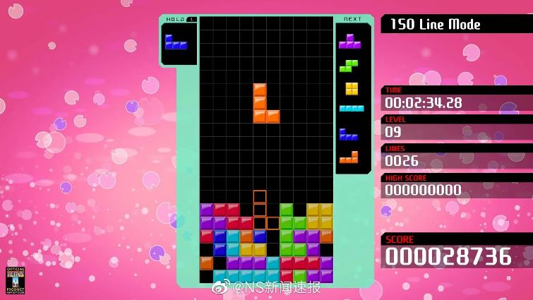
1. Tetris Features
Created in 1984
By Alexei Pajitnov (Russian)

Slide 5
1. Tetris Features
There should be a grid to play
There should be some different patterns
The patterns can be rotated
The patterns should automatically fall
The patterns can be move left or right
The patterns will be eliminated when a line is filled
The game is over when the new patterns reach the top

Slide 6
Agenda
Tetris Features
Implementation on C
Implementation of hardware
UI and Demo
Problems and Issues

Slide 7
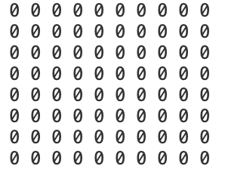
2. Implementation on C
There should be a grid to play
int array[20 * 15]
0: empty
1: current block
2: fixed block (in the bottom)

Slide 8
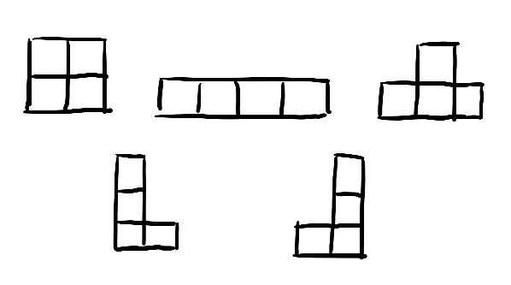
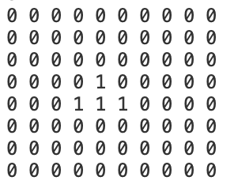
2. Implementation on C
2. There should be some different patterns
5 different types of blocks

Slide 9
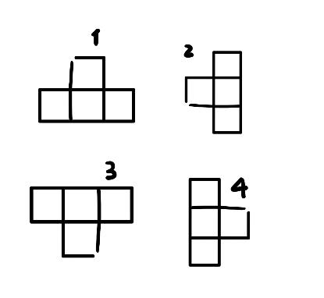
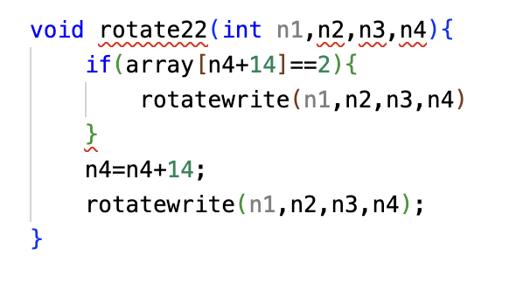
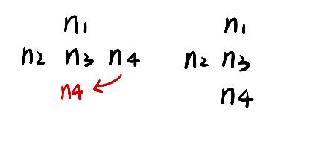
2. Implementation on C
3. The patterns can be rotated
Notes:
In order to record each block in the pattern, we have four index n1 n2 n3 n4 as global variable. When we rotate the pattern from 1 to 2, we can think it as moving n4 from the right of n3 to the bottom of n3. By doing this, we need to add 14 to the n3’s current index. Why? because we have 15 numbers for one row.

Slide 10
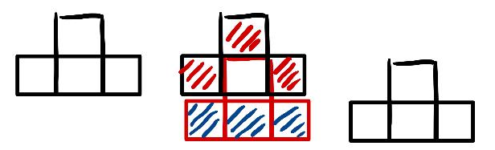
2. Implementation on C
4. The patterns should automatically fall
Eliminate 3 blocks
Add 3 blocks

Slide 11
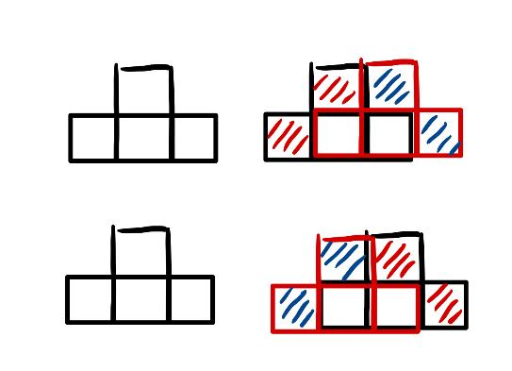
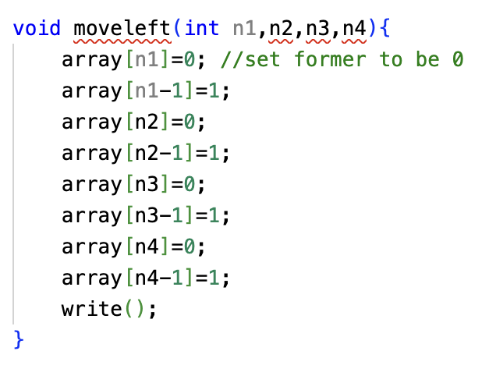
2. Implementation on C
5. The patterns can be move left or right

Slide 12
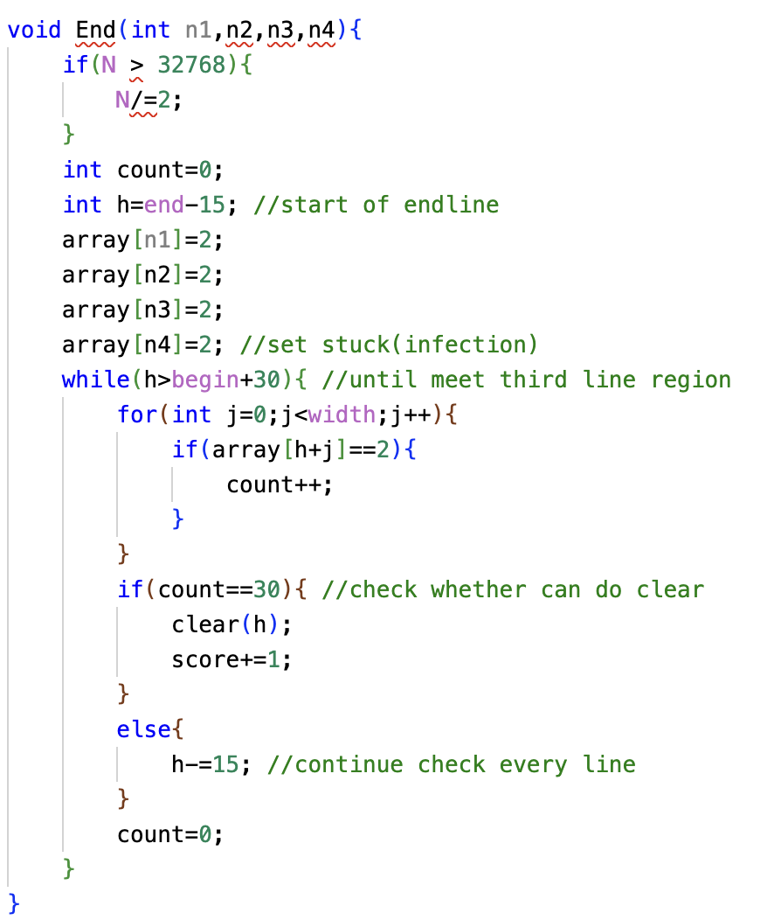
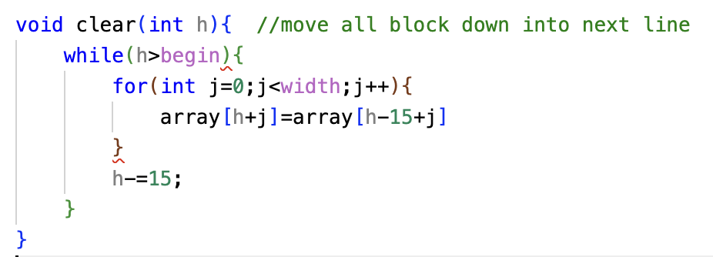
2. Implementation on C
6. The patterns will be eliminated when a line is filled
Check if the sum of the line is filled by blocks
If so, the each elements in the line will be replaced by the elements in the line above.
Notes:
When a line is filled by blocks, it will be eliminated. We can calculate the sum of each row. If the sum is 30, which means there are 15 2 in this line. In this case, every element in the line above will be moved down to the corresponding position of current line, and so on.

Slide 13
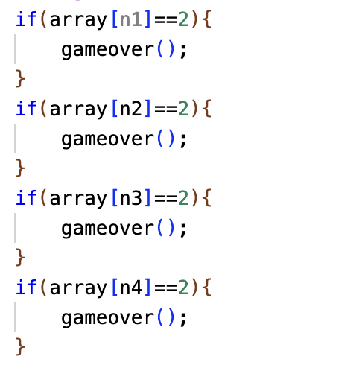
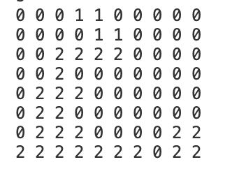
2. Implementation on C
7. The game is over when the new patterns reach the top

Slide 14
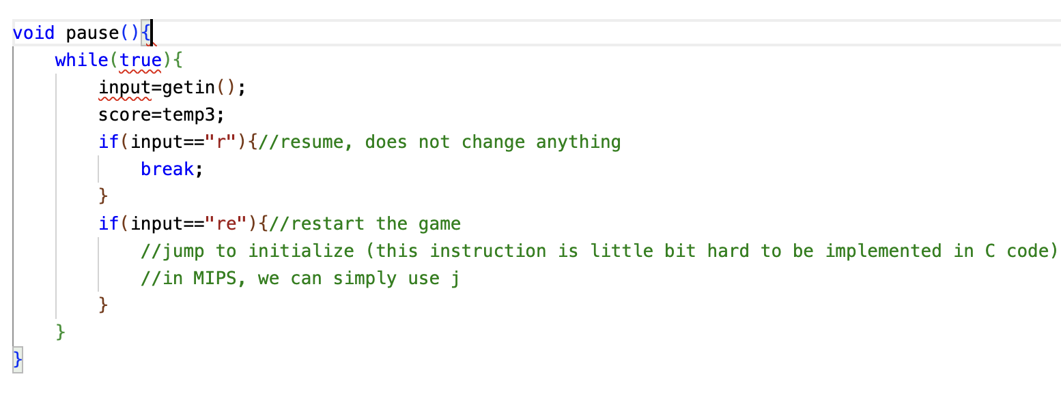
2. Implementation on C – Add-ons
1. Pause
Use an infinite loop to pause
It will be paused until the input for “r” is pressed

Slide 15
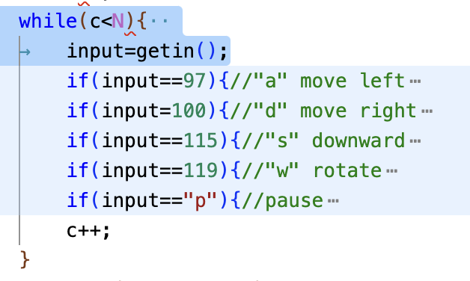
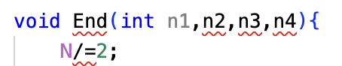
2. Implementation on C – Add-ons
2. SpeedUp
Set an N as the 2^22
Each time when a pattern reaches the bottom, N /= 2
Con: The “speed up” might not be that significant
The speed depends on CPU
Notes:
When it comes to speed up, we use a integer N, which is 2 to the power of 22. We keep adding the integer c from 0 to N, to make the program wait. Every time when a pattern reach the bottom, we divide the N by 2, until it become 2 to the power of 15. As a result, users can feel that the patterns are dropping faster than before.

Slide 16
Agenda
Tetris Features
Implementation on C
Implementation of hardware
UI and Demo
Problems and Issues

Slide 17
3. Implementation of hardware
VGA
buffer
user
ps2
input
conversion
(regfile)
processor

Slide 18
Agenda
Tetris Features
Implementation on C
Implementation of hardware
UI and Demo
Problems and Issues

Slide 19
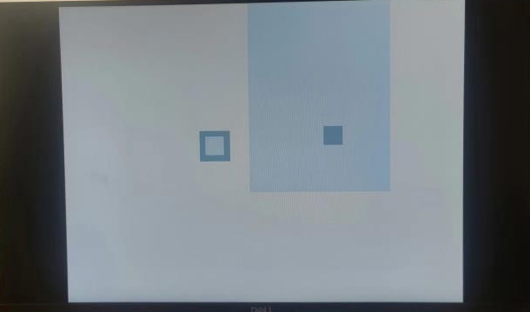
4. UI and Demo
Game space
Background
Score space

Slide 20
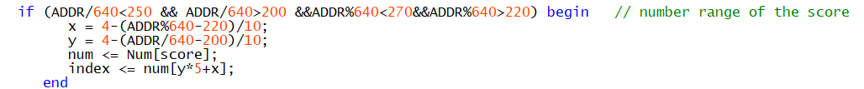

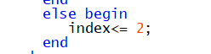
4. UI and Demo
Game space
Background
Score space

Slide 21
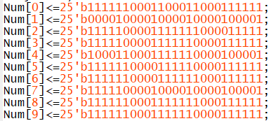
4. UI and Demo
Game space
Background
Score space: Use relative coordinates to generate numbers

Slide 22
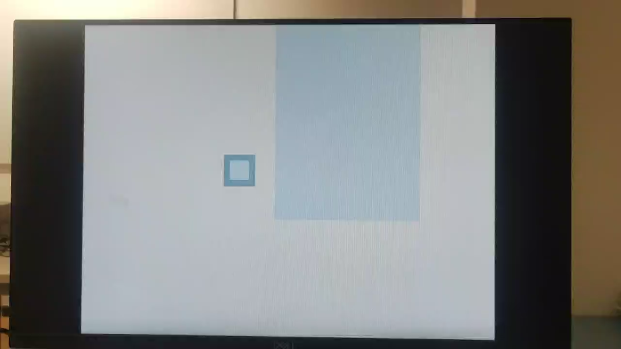
4. UI and Demo

Slide 23
Agenda
Tetris Features
Implementation on C
Implementation of hardware
UI and Demo
Problems and Issues

Slide 24
5. Problems and Issues
Translating C into MIPS
We used some fancy styles to write the C code
BUT, something cannot be translated:
For example: struct
Sol: use very SIMPLE and REDUNDENT C code

Slide 25
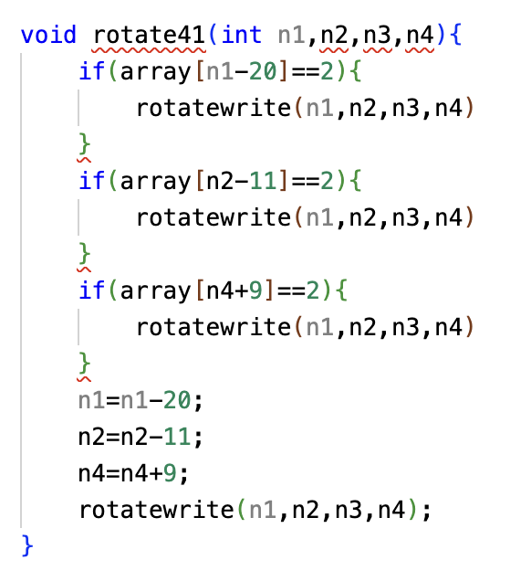
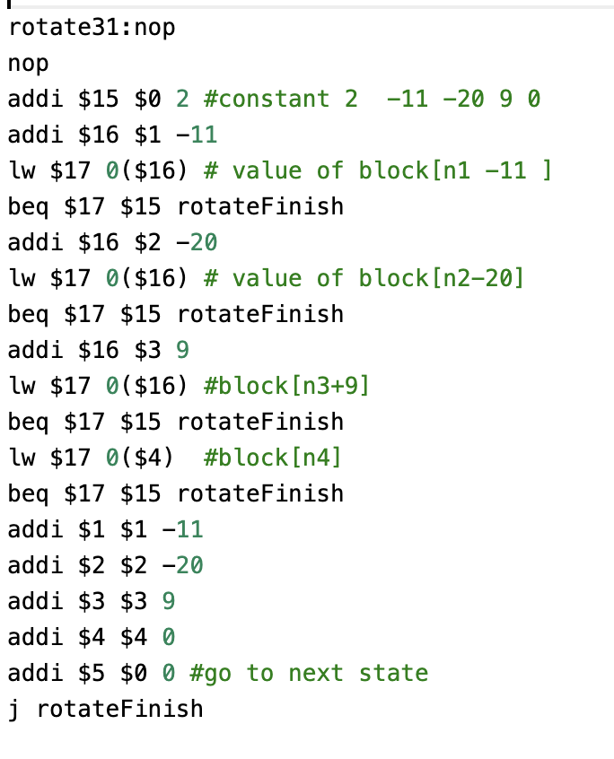
5. Problems and Issues
Translating C into MIPS

Slide 26
5. Problems and Issues
2. The continuous control signal of PS2 Keyboard
Well, due to some un-solved problems, the keyboard’s signal will continuously input to the CPU.
For example: it keeps rotating after you clicked “w”
Sol: Click another key to stop the signal

Slide 27
Q&A

Slide 28

Thank you for coming :)

